Slide 1
“Difference between Informed and Uninformed Search in AI”
Muhammad Taqui
01-136221-021

Slide 2
Introduction
Search algorithms are an essential part of problem-solving in Artificial Intelligence. They enable machines to explore a problem space and find optimal solutions to complex problems.
Search algorithms can be classified into two categories:
Uninformed search
Informed search
Understanding the difference between these two types of search algorithms is crucial for developing efficient and effective AI systems. Search algorithms are used in various real-world applications, such as route planning, game playing, and natural language processing.

Slide 3
Uninformed Search
Uninformed search, also known as blind search, is a type of search algorithm that does not use any additional information about the problem to guide its search. Uninformed search algorithms explore the problem space in a systematic way, checking each possible path one by one until a solution is found. These algorithms have no knowledge of the structure of the problem space and do not make any assumptions about the location of the goal.

Slide 4
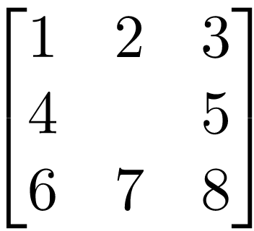
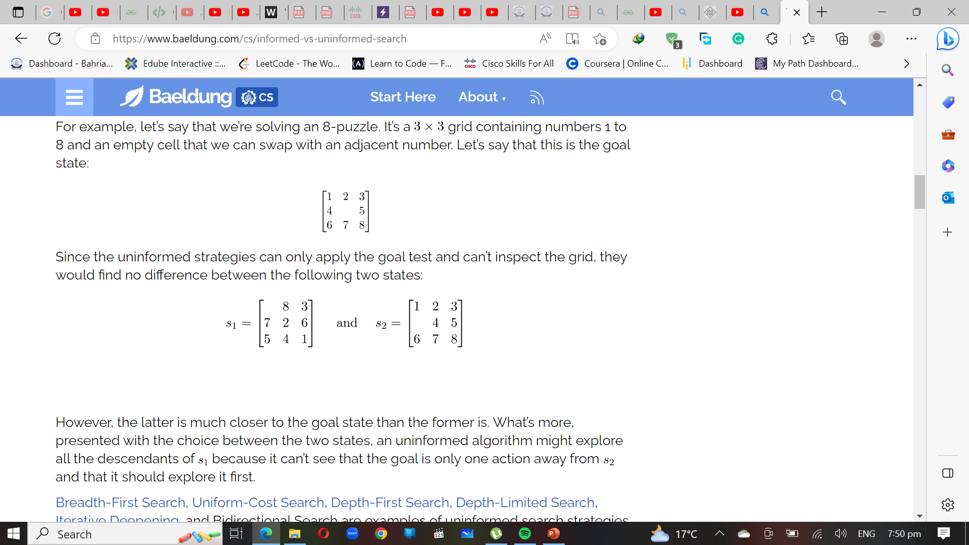
Examples
let’s say that we’re solving an 8-puzzle. It’s a 3x3 times grid containing numbers 1 to 8 and an empty cell that we can swap with an adjacent number.
Let’s say that this is the goal state:
Since the uninformed strategies can only apply the goal test and can’t inspect the grid, they would find no difference between the following two states:

Slide 5
Uninformed Search
Uninformed search algorithms can be very inefficient when searching large problem spaces as they have no way to prioritize certain paths over others. They may waste time exploring paths that are unlikely to lead to a solution. However, uninformed search algorithms are useful in some situations, such as when the problem space is small, and the goal state is easy to find.

Slide 6
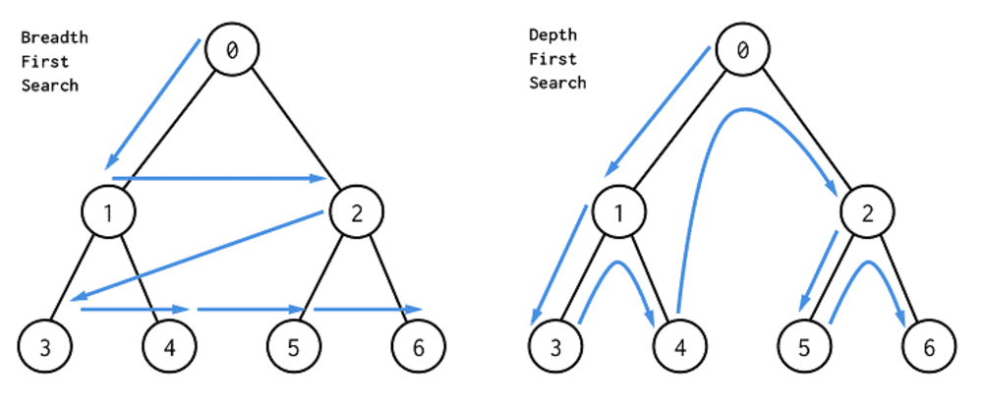
BFS & DFS
BFS=Queue
DFS=Stacks

Slide 7
Informed Search
Informed search, also known as heuristic search, is a type of search algorithm that uses additional information about the problem to guide its search. Informed search algorithms make more informed decisions about which paths to explore by using a heuristic function that estimates the cost of reaching the goal from a given state.

Slide 8
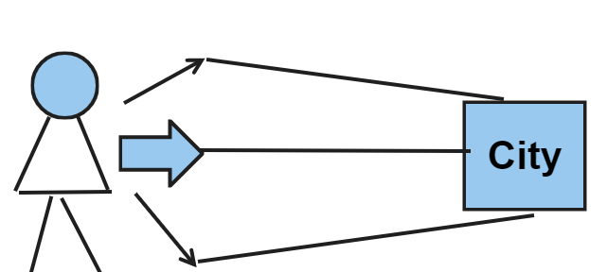
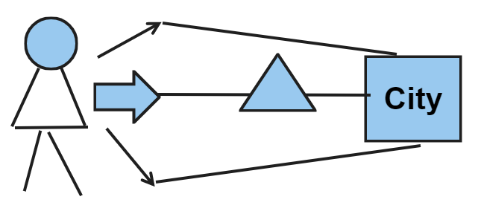

Heuristic Function
Heuristic is a function that is used in Informed Search, and it finds the most promising path. It takes the current state of the agent as its input and produces the estimation of how close the agent is to the goal.
Euclidean distance Quick but not optimal

Slide 9
There are different types of informed search algorithms, such as A* Search and Greedy Best-First Search, which differ in the way they use the heuristic function to guide their search. A* Search uses a combination of the heuristic function and the cost of reaching a state to determine the priority of exploring a state. Greedy Best-First Search uses only the heuristic function to determine the priority of exploring a state.

Slide 10
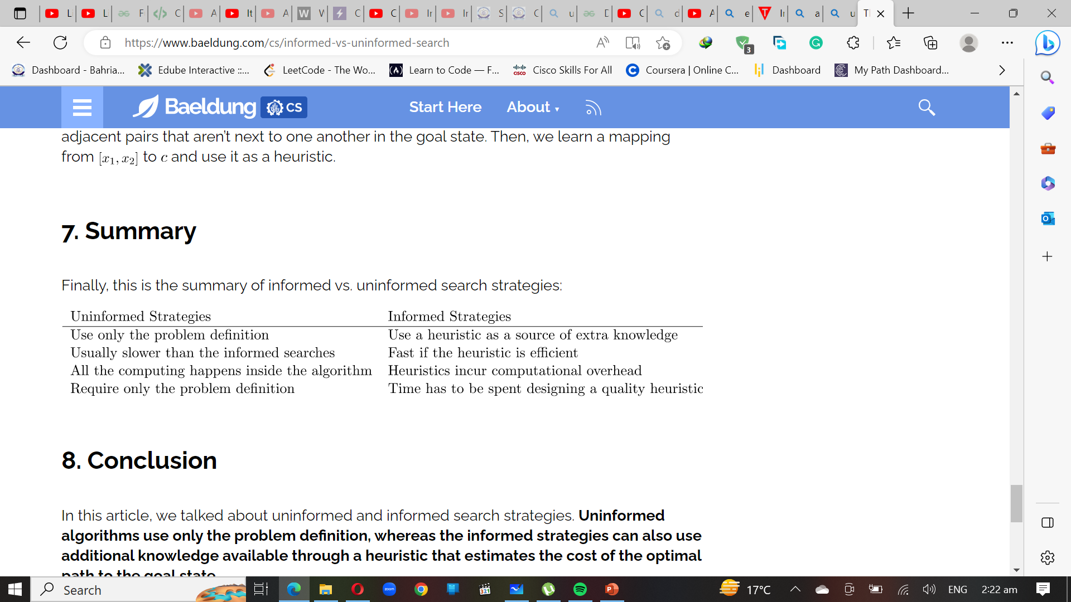




Summary

